Slide 1
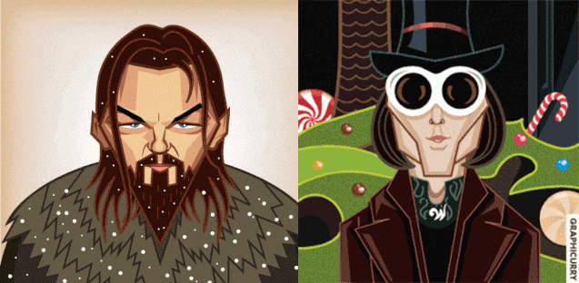
Is he a doctor?

Slide 2
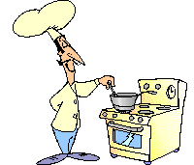
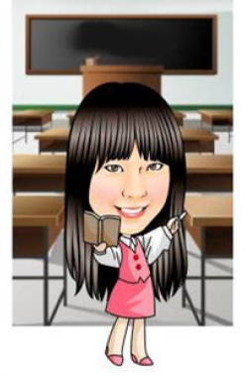
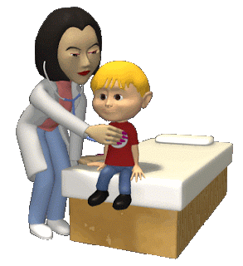
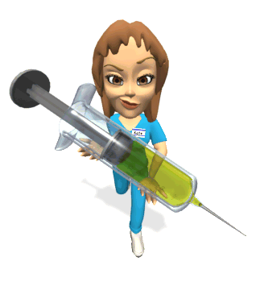
a teacher
a cook
1
2
3
a student
5
Boom!
4
a nurse
6
a doctor

Slide 3
Are you a cook?
Yes, I am.
Is she a doctor?
No, she isn’t.
Is he a student?
Yes, he is.

Slide 5
Challenge Time

Slide 6
Is she a student?

Slide 7
Is he a cook?

Slide 8
Is she a nurse?

Slide 9
Are you a doctor?

Slide 10
Is he a teacher?

Slide 11
Is he a student?

Slide 12
Is he a doctor?

Slide 13
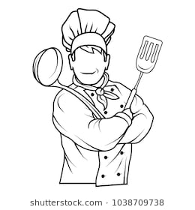
Are you a nurse?

Slide 14
Is she a cook?

Slide 15
Is he a teacher?

Slide 16
【本週英語作業】
1.聆聽和跟讀英語 CD。
2.完成FB讀寫練習本P21-P24。

